Slide 1

Visual Analytics on Credit Cards Default
Erasmus students:
Carla Pascual - 1840620
Federico Arcos - 1879280

Slide 2

Index
Introduction
Project data
Visualization
3.1 Scatterplot
3.2 Parallel Coordinates
3.3 Linechart
3.4 Stacked bacharts
3.4.1 Age
3.5 New Data Form
Analytics

Slide 3
1. Introduction
This project consists in the visualization of the data of credit card owners so that a bank manager knows the clients that supposedly will not be able to pay the invoice of their credit card the following month
We mainly pay attention to the latest payments made by customers and the balances of their corresponding bank accounts
The system is based on an automatic learning algorithm to classify new clients, which can be added from the interface using a form and to represent them by updating all the views.
The prediction is made by an automatic learning algorithm
It is also combined with an efficient visualization of the entire data set.

Slide 4

2. Project data
The data of our project has been taken from the following database: https://archive.ics.uci.edu/ml/datasets/default+of+credit+card+clients
It contains approximately 30,000 tuples, each with 24 attributes
Some values ​​were eliminated to have useful and interesting data, to finally obtain a set of 15,337 tuples and 19 attributes.
This calculation was made using the Python function "preprocessing.action ()", which creates a new csv file named dataset.csv.
We have six numerical attributes named, one for each month from September 2005 to April 2005

Slide 5
3. Visualization
The visualization is constituted by 7 views, each with different aspects of the data set.
All of them are coordinated with each other, so when clicking on an element of a certain view, the controller of the event will highlight some elements in the others and / or show other information.
When a new client is added, all views change according to the newly added tuple.
3.1 Scatterplot
3.2 Parallel Coordinates
3.3 Linechart
3.4 Stacked bacharts
3.4.1 Age
3.5 New Data Form

Slide 6
3.1 Scatterplot
Each point represents a customer and the color codes the customer's classification
The color scale used is d3.scaleOrdinal (d3.schemeCategory10)
We decided to apply PCA because it is fast and does not require a deep knowledge of the problem, and then we take the first 2 components. This work is done using the python function pca.action () using pandas to read and analyze the original data set of csv and sklearn to calculate the PCA values. The result is saved in pca.csv.
Each point has two associated event handlers. The first one allows to make visible information about tools that shows the client's ID by just passing the mouse over it; This controller also makes the point larger so that it is more visible. The second controller is associated to click on events:

Slide 7
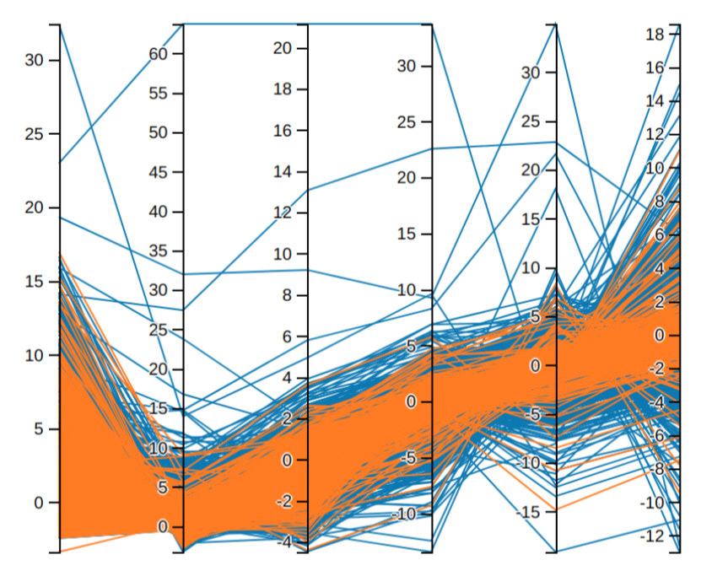
3.2 Parallel Coordinates
We have six axes, which correspond to the first six main components given by the PCA algorithm applied in the original data set (dataset.csv).
Each line refers to a single point that is the graphic representation of a client.
There is the possibility to click on a line to select it and see the corresponding point in the scatter diagram highlighted along with all the related information.
In addition, it is possible to exchange the order of the axis, dragging the axis that we want to move.

Slide 8
3.3 Linechart
In the chart you can distinguish two lines: the green represents the amount of money that the client had in his bank account in the specified period, while the red represents the payments he made with his credit card.
The values ​​that are often represented are not of the same order of magnitude, so we had to calculate a standardized version of the data set (saved in standardized data.csv) by using the Standardization.action () function, which applies a standard scaler numpy [3] to all these amounts.
In each line there are 6 circles that can be moved with the mouse to see in an information about tools the original value of that point, while in the y axis the normalized values ​​are represented.

Slide 9
3.4 Stacked Barcharts
It can be seen to see at the same time the frequency distribution of the correct and predetermined clients.
There is a column for each different value of the categorical attribute, composed of two sub-columns. Each of them represents the percentage of predetermined (at the bottom) and correct (at the top) instances in the data set. This data is taken from frequency.csv.
An information on tools shows the mouseovering on a single bar; contains the number of instances, taken from * instance.csv, within its classification and its value for the attribute under examination.
Finally, you can click on each bar: it will be highlighted along with all the points in the scatter diagram and the lines in the parallel coordinates.
Once the user clicks on a point in the scatter plot or on a line in the parallel coordinates, the bars, which correspond to the value of the respective attribute for the selected customer, are highlighted in each stacked bar chart.

Slide 10
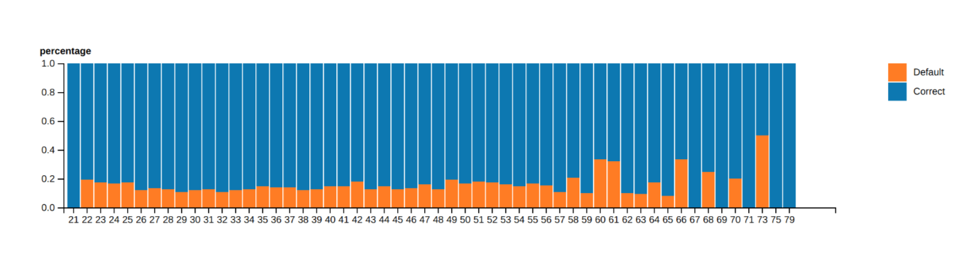
3.4.1 Age
This stacked bar chart corresponding to age behaves in the same way as the others, but contains something else.
the columns are arranged according to the order of ages, but we add the possibility of changing the order and order them according to the predetermined percentage.

Slide 11
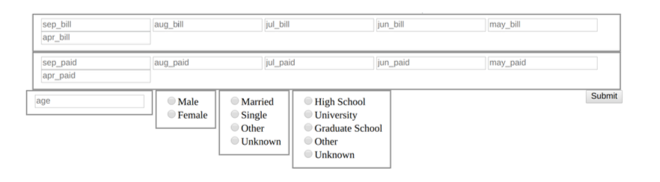
3.5 New Data Form
The bank manager may be interested in knowing if a customer that is not in the data set with certain values ​​values ​​will be predetermined or correct.
Through this form, it will insert all the values ​​associated with this new instance. When sending them, the new tuple will be classified using an automatic learning algorithm.
The browser page will be reloaded and the new point will be highlighted in the scatter diagram.

Slide 12
4. Analytics
Because Javascript is not so fast in handling a large amount of data and is not suitable for calculations, we need a Python program.
To do this, we configure a small web server using the Python library flask, which can communicate with the visualization, which can be accessed after starting the server at the address http://127.0.0.1:5000 (or http: // localhost: 5000).
It is possible to pass each field value of the form using the AJAX call, which sends an HTTP POST message to a fixed route of our web server, which contains a JSON load that includes all the fields.
Subsequently, he begins to train an SVM trainee with all the preclassified instances present in the original data set (dataset.csv).
SVM is an automatic learning algorithm that tries to find a hyperplane that maximizes the margin between itself and the closest points in the high dimensional space. In this case, SVM works in a kernelized space with a rbf kernel.

Slide 13
4. Analytics
To calculate a cross-validation 3 times on the server by setting the last parameter to 1.
Once the web server receives the HTTP POST message from the Javascript code, it creates a new tuple that will be added to dataset.csv and will classify it using the pre-trained SVM classifier. The new line is added, and then the function calls all our Python modules, which will recalculate all the additional csv files (for example, * frequency.csv and * instance.csv), required by the interface.
At the end of the calculation, it returns the ID associated with the newly added client to the Javascript code. At this point, Javascript can make an alert message that shows the ID returned.

